Slide 1
Feature-Based Knowledge in Knowledge Distillation
Hao Gao

Slide 2
Outline
middle layer outputs
parameters(sharing/distribution)
neuron activation

Slide 3
Outline
Middle layer outputs
Fitnets: Hints for Thin Deep Nets
Paying More Attention to Attention: Improving the Performance of Convolutional Neural Networks via Attention Transfer(ICLR17)
Paraphrasing Complex Network: Network Compression via Factor Transfer (NIPS2018)
Parameters(sharing/distribution)
Neuron activation

Slide 4
Motivation
Traditional Neural networks are wide and deep
Time and consuming
Compress Model
Proposed Method
Deep
Thin

Slide 5
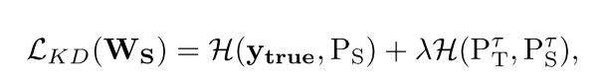
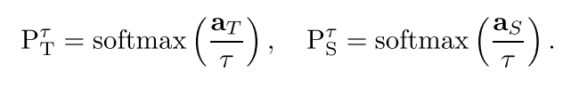
Method
Review of KNOWLEDGE DISTILLATION
Hint-based training

Slide 6
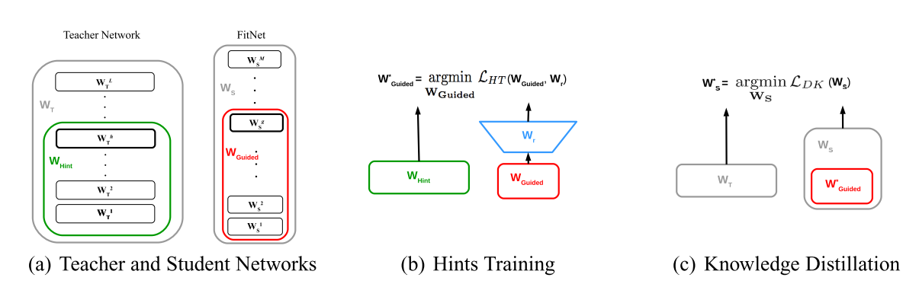
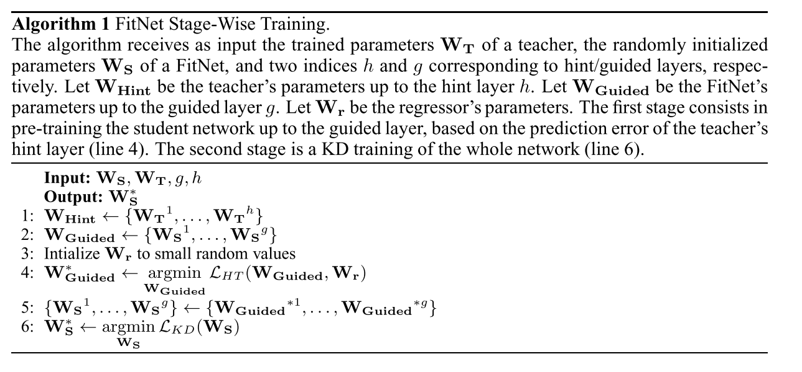
Optimization

Slide 7
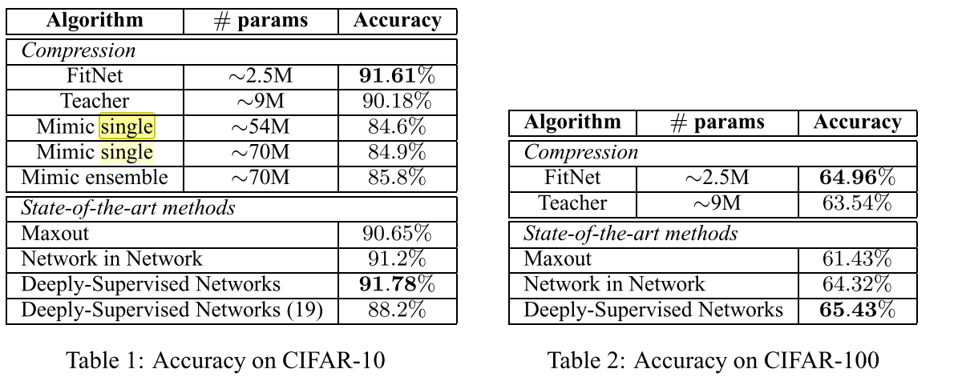
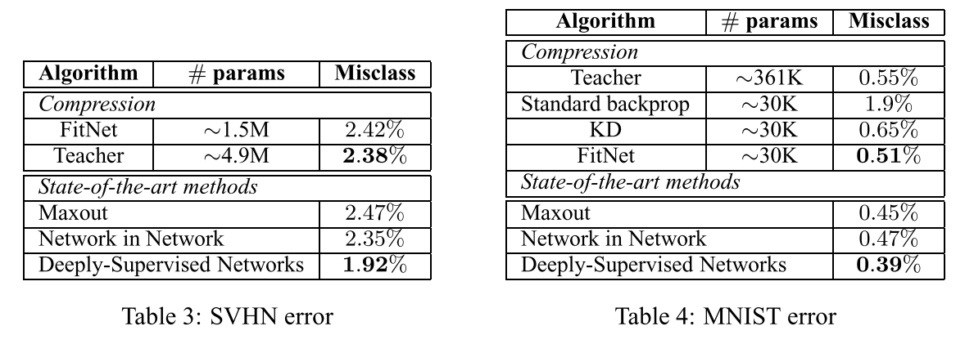
Experiment: Performance

Slide 8
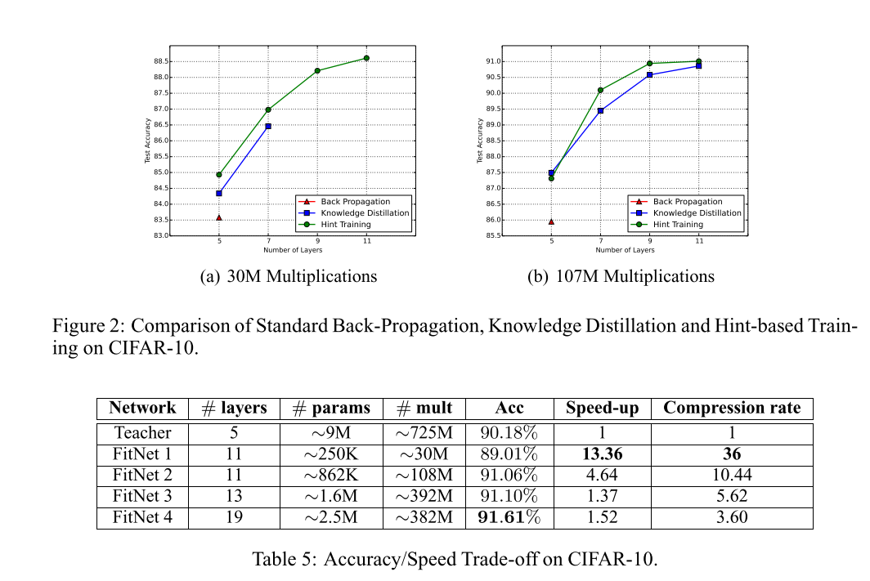
Experiment: Ablation Study

Slide 9
Outline
Middle layer outputs
Fitnets: Hints for Thin Deep Nets
Paying More Attention to Attention: Improving the Performance of Convolutional Neural Networks via Attention Transfer(ICLR17)
Paraphrasing Complex Network: Network Compression via Factor Transfer (NIPS2018)
Parameters(sharing/distribution)
Neuron activation

Slide 10
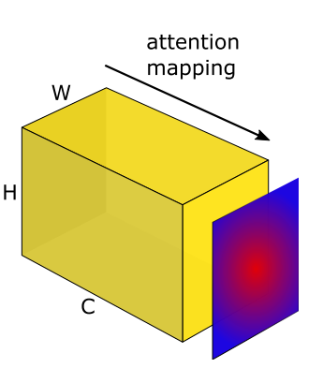
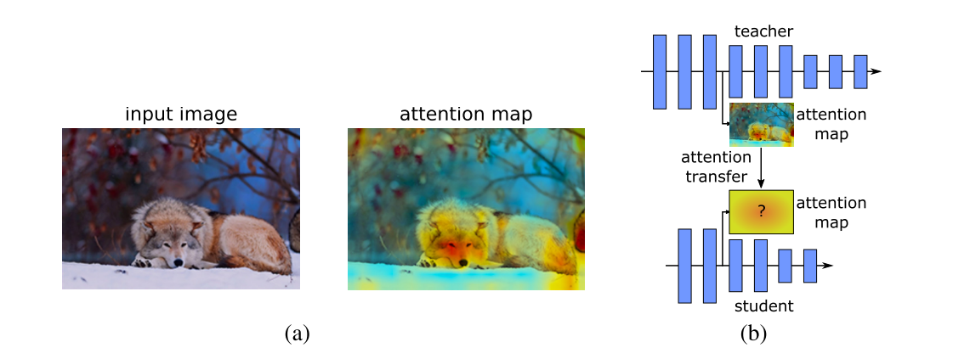
Motivation
Use attention to improve the performance of CNN
Transfer attention from teacher network to student network
Category
Activation-based
Gradient-based

Slide 11
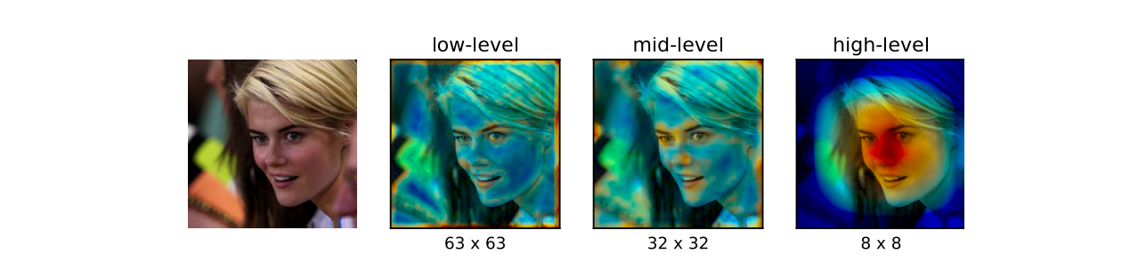
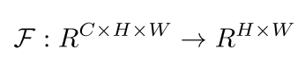
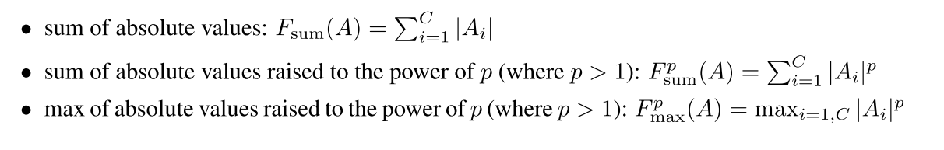
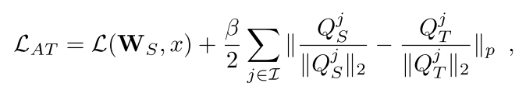
Method
Activation-based attention transfer
Activation based mapping function
Loss

Slide 12
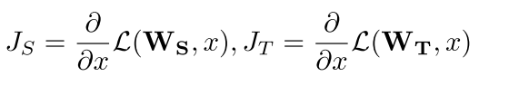
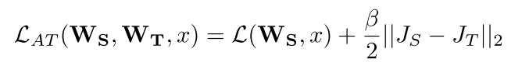
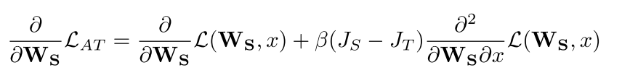
Method
Gradient-based attention transfer
Define the attention as gradient w.r.t input
Loss
Derivative

Slide 13
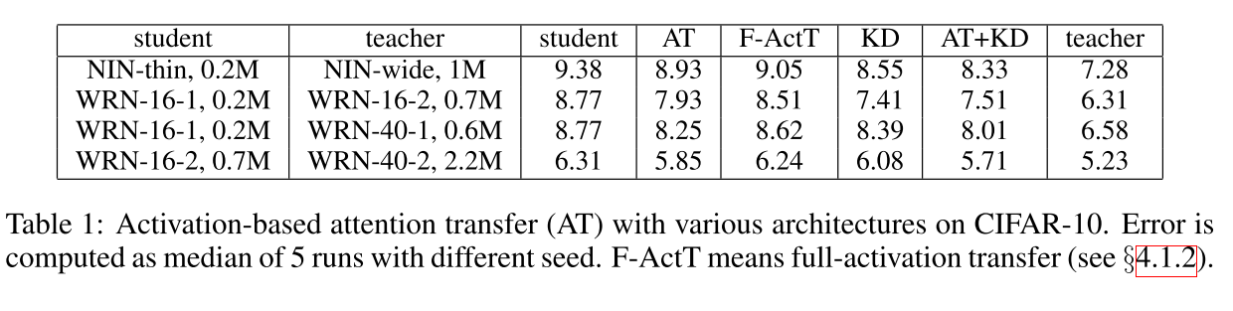
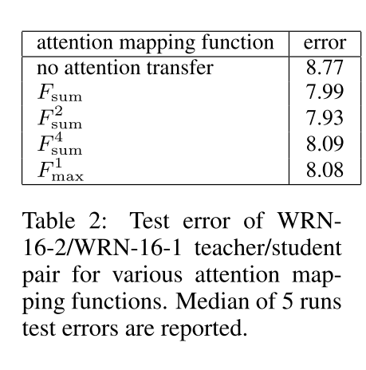
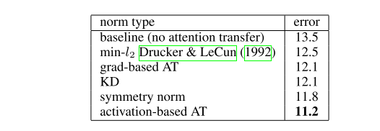
Experiment

Slide 14
Outline
Middle layer outputs
Fitnets: Hints for Thin Deep Nets
Paying More Attention to Attention: Improving the Performance of Convolutional Neural Networks via Attention Transfer(ICLR17)
Paraphrasing Complex Network: Network Compression via Factor Transfer (NIPS2018)
Parameters(sharing/distribution)
Neuron activation

Slide 15
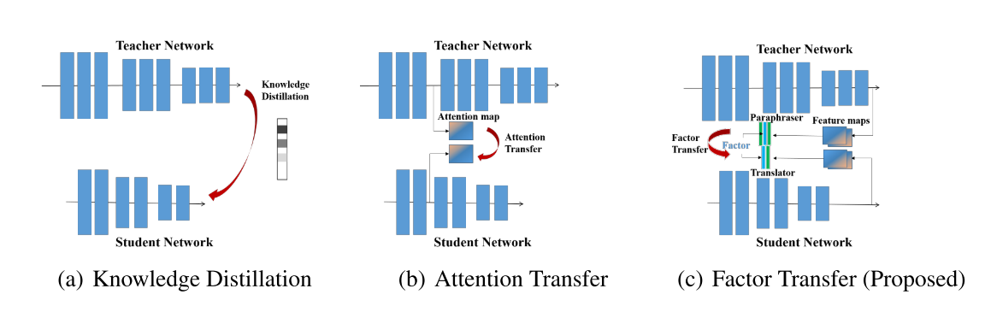
Motivation
Traditional method directly transfers the teacher’s output
Overlook the differences between teacher and student network(Structure, Channels, initial conditions)
Translate the knowledge: Factor transfer

Slide 16
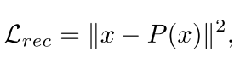
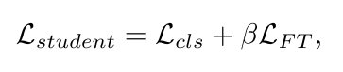
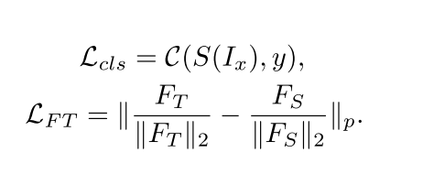
Method
Teacher Factor Extraction with Paraphraser
Factor Transfer with Translator

Slide 17
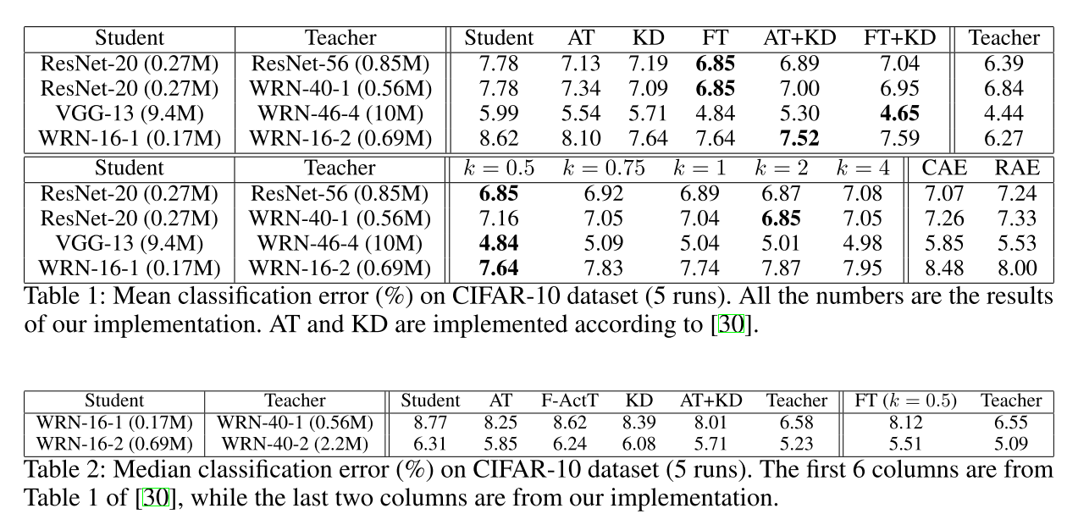
Experiments

Slide 18
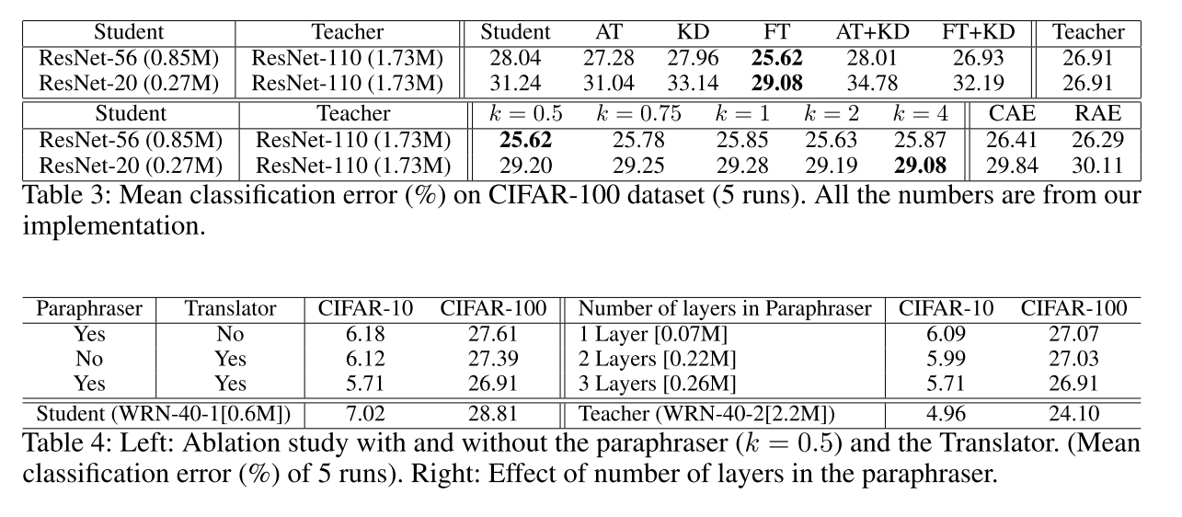
Experiments

Slide 19
Outline
Middle layer outputs
Parameters(sharing/distribution)
Rocket Launching: A Universal and Efficient Framework for Training Well-performing Light Net(AAAI2018)
Knowledge Representing: Efficient, Sparse Representation of Prior Knowledge for Knowledge Distillation(CVPR2019)
Neuron activation

Slide 20
Introduction
Share some lower layers
Train teacher and student network simultaneously

Slide 21
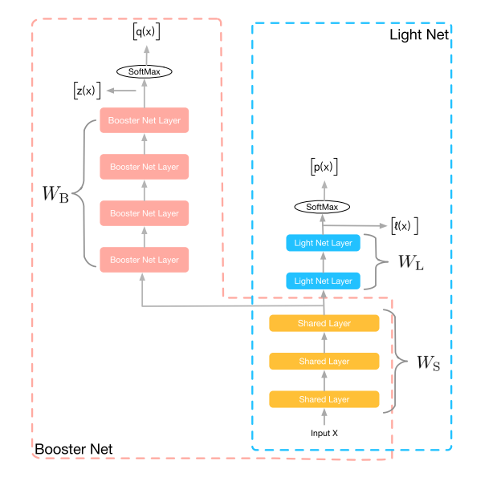
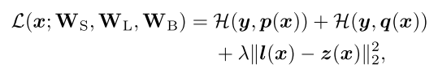
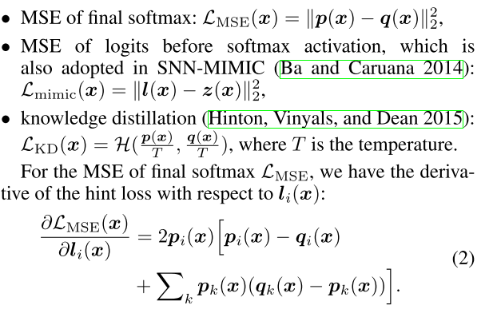
Method
Objective function
Hint loss function
Parameter sharing
Simultaneous training

Slide 22
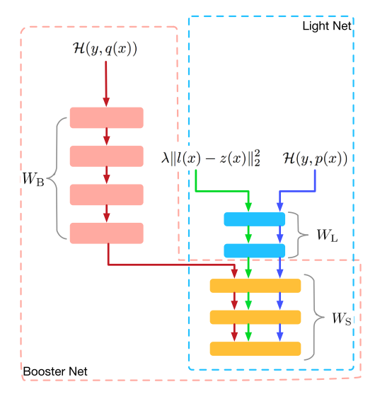
Method
Gradient block
Prevent the effectiveness of student network from teacher network
During the back-propagation of the hint loss term, we fix the gradient of booster net’s specific parameters (WB)

Slide 23
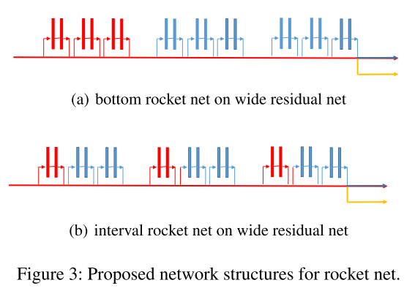
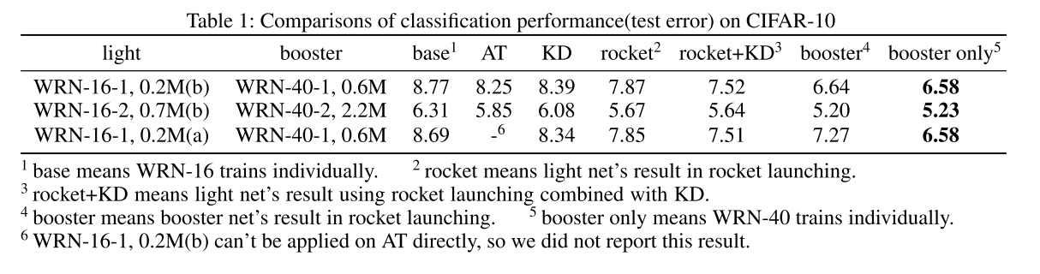
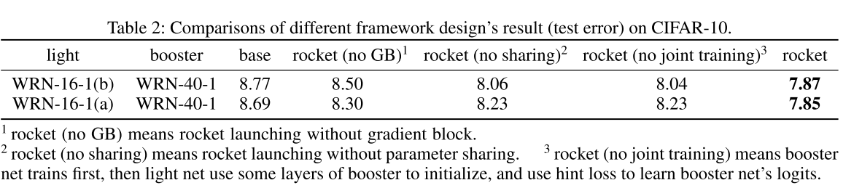
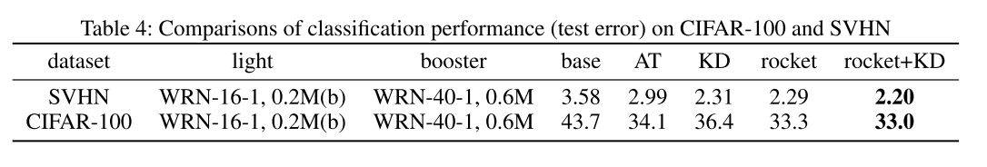
Experiments

Slide 24
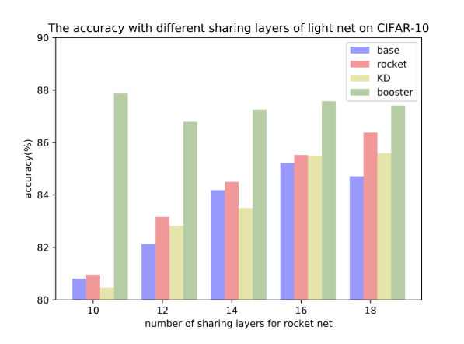
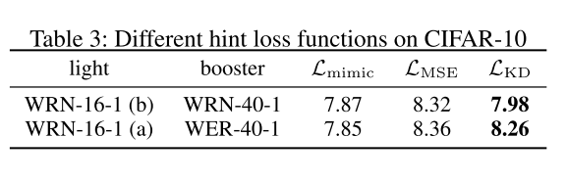
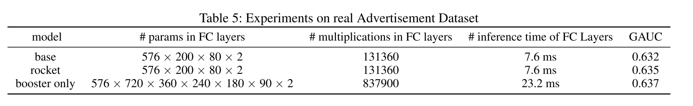
Experiments

Slide 25
Outline
Middle layer outputs
Parameters(sharing/distribution)
Rocket Launching: A Universal and Efficient Framework for Training Well-performing Light Net(AAAI2018)
Knowledge Representing: Efficient, Sparse Representation of Prior Knowledge for Knowledge Distillation(CVPR2019)
Neuron activation

Slide 26
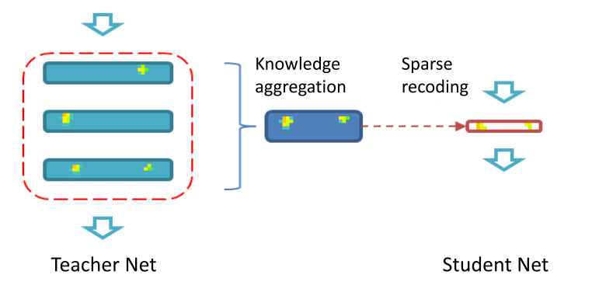
Motivation
The capacity of student network is not enough
optimization errors between two networks will be accumulated from layers

Slide 27
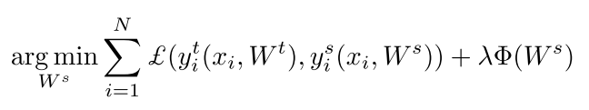
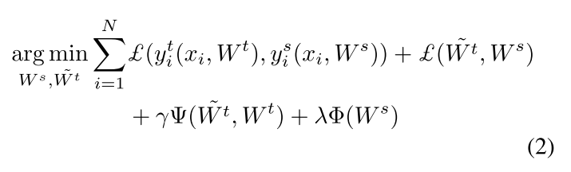
Method
Review of KD
However…
Student network is usually weak
New objective function
Aggregation
Sparse recoding

Slide 28
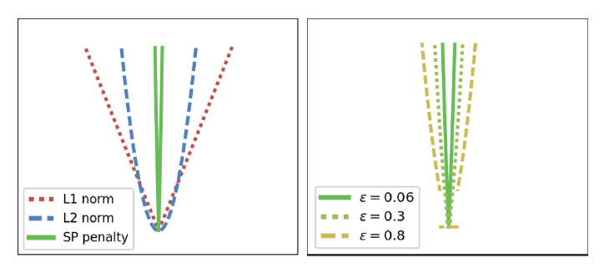
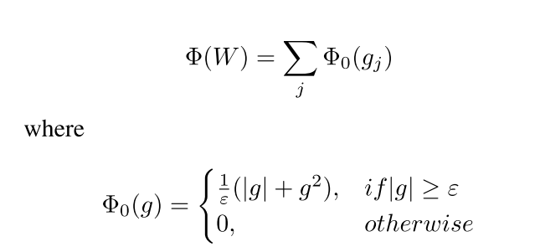
Sparse recoding
Reason
gradients are not discriminative enough, which causes oscillatory
Keep the large value while discard the small value of gradient
Formulation
类似于feature importance

Slide 29
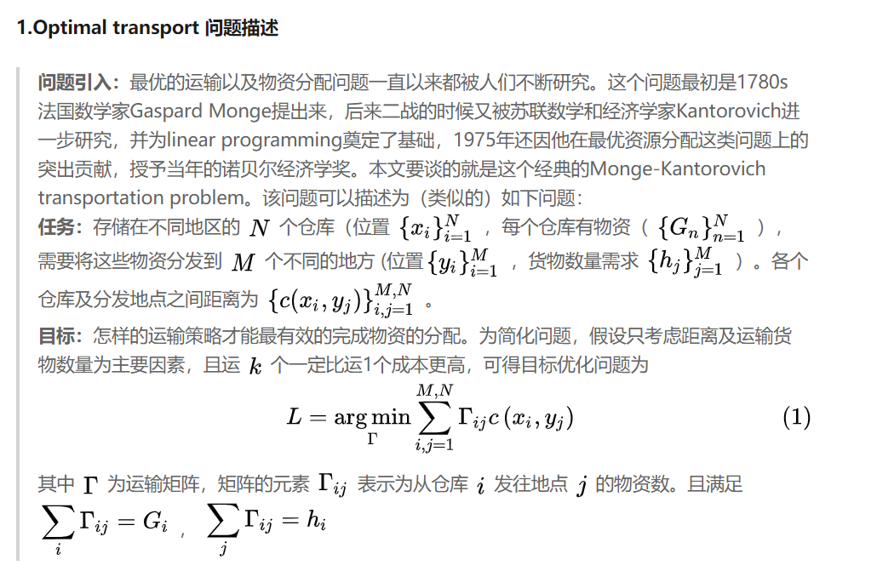
Deep Knowledge Aggregation
Optimal transportation

Slide 30
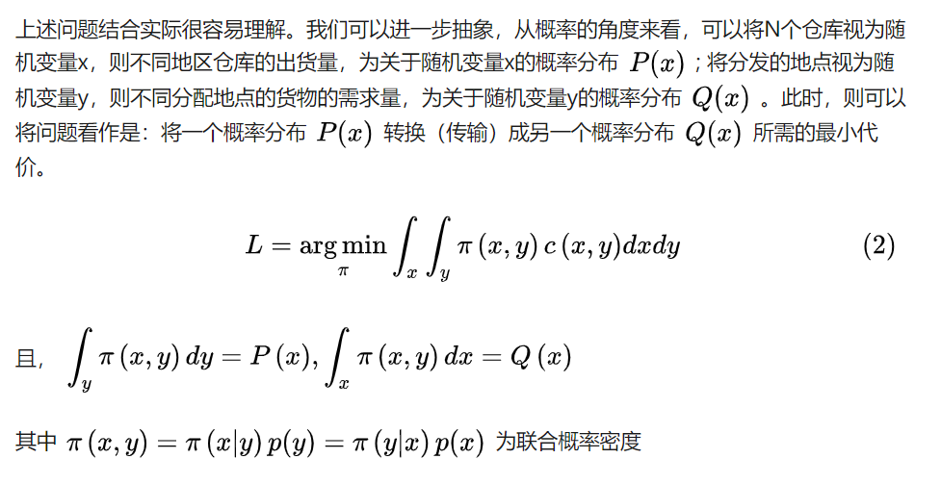
Deep Knowledge Aggregation
Optimal transportation

Slide 31
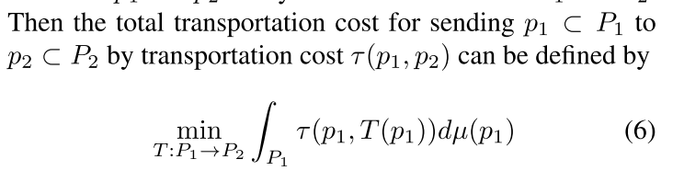
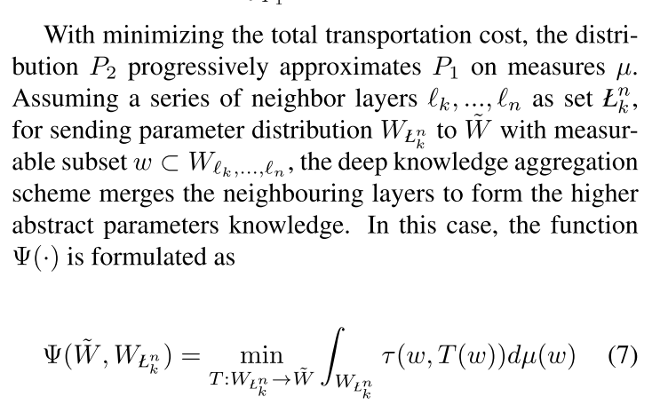
Deep Knowledge Aggregation
Transportation cost
Formulate

Slide 32
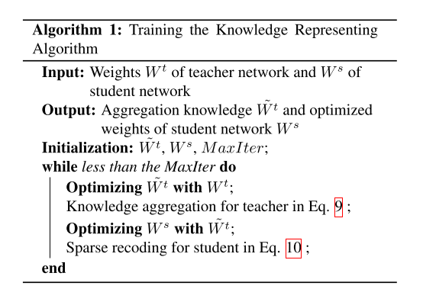
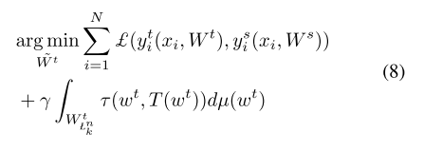
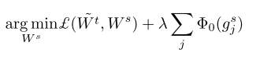
Optimization
Objective Function

Slide 33
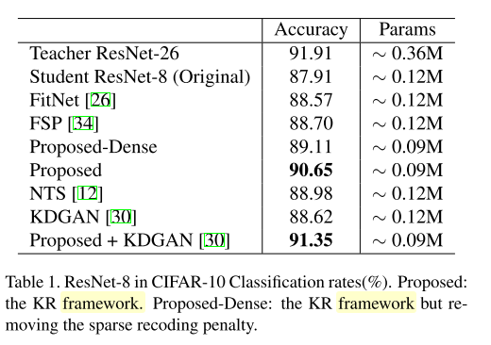
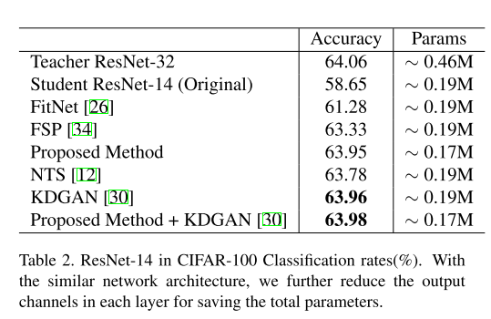


Experiments

Slide 34


Experiments

Slide 35
Outline
Middle layer outputs
Parameters(sharing/distribution)
Neuron activation
A Comprehensive Overhaul of Feature Distillation (ICCV2019)

Slide 36
Motivation
Transferring only the output is similar to training the student with the ground truth
Aspects
teacher transform
student transform
distillation feature position
distance function

Slide 37



Method

Slide 38


Method
Teacher transform
Transfer two factors from features
The magnitude of feature response after Relu
Activation status of each neuron
Margin Relu
保留一些负值
Notes:
正值都保留，负值被抑制。这样的话就不用学习精确的“没有用”的负值，而集中精力学习“有用”的正值。
如果教师网络的特征值是正的，学生网络必须产生与教师网络相同的特征值。反之，如果教师网络的特征值为负，则学生网络产生的特征值应小于零，使神经元处于相同的激活状态。

Slide 39

Method
Student transform
use a 1×1 convolutional layer as a student transform
Distill position
Between first relu and a block
Keep the activation status

Slide 40


Method
Distill distance
Notes:
我们的蒸馏是在ReLu前做的，如果teacher小于0时，student比它小就不必惩罚，因为经过ReLU后是一样的

Slide 41


Experiments

Slide 42

Experiments

Slide 43
Thanks！

